Slide 1

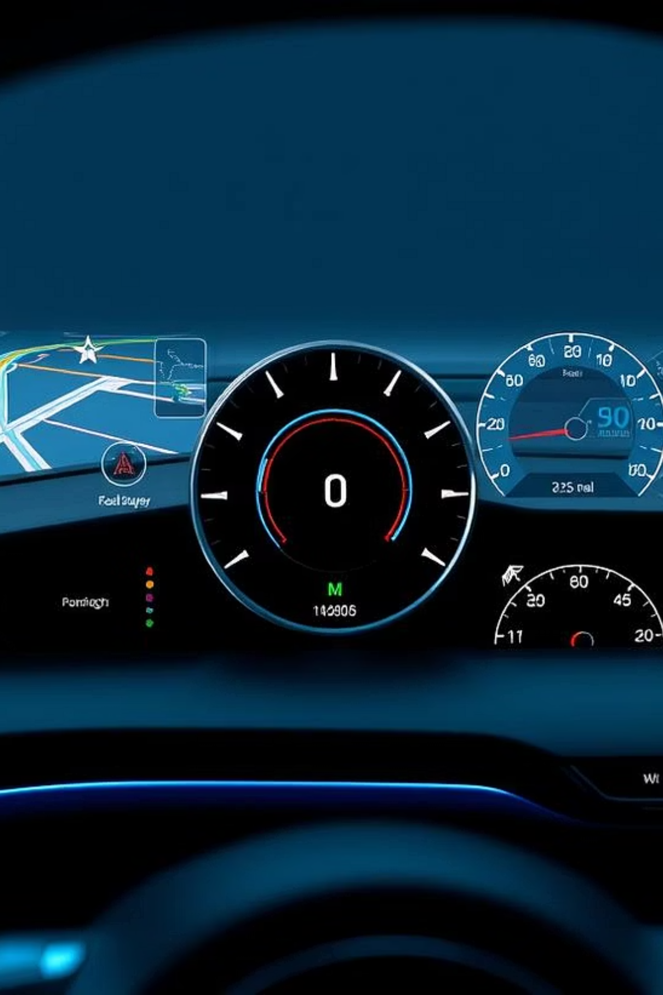
Car Sales and Price Analysis Dashboard

Slide 2
Objective of the Project
Understand Key Factors
Analyze Sales Trends
Identifying the primary variables influencing car prices in the Norwegian market.
Gaining insights into current and historical car sales trends specific to Norway.
Interactive Visualizations
Enable Data-Driven Decisions
Leveraging Power BI to create dynamic and user-friendly data dashboards.
Providing stakeholders with actionable insights for strategic business planning.

Slide 3

Dataset Overview
Data Sources
Key Features
cars_dataset.xlsx: Detailed car features and pricing information.
Make and Model
Engine Type
Fuel Type
Norway_car_sales_by_make.csv: Comprehensive sales data broken down by car brand.
Price
Year of Manufacture
car_details.pbix: The Power BI project file containing all visualizations.
Mileage
Transmission Type

Slide 4
Data Cleaning & Preparation
Extracted Relevant Fields
Standardized Car Brand Names
Isolated crucial data points such as Year, Fuel Type, and Transmission for focused analysis.
Duplicate Removal & Missing Values
Unified brand nomenclature for consistent analysis across datasets.
Ensured data integrity by eliminating redundant entries and addressing gaps.
These steps ensure high-quality data for accurate analysis and meaningful insights.

Slide 5
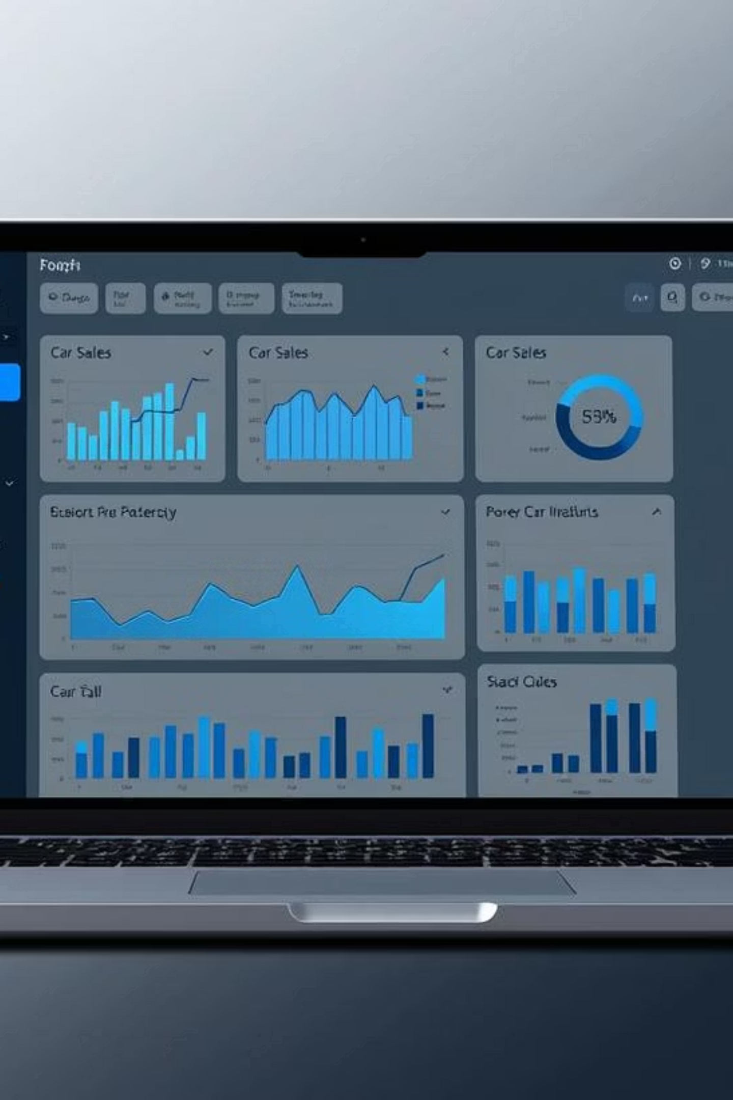
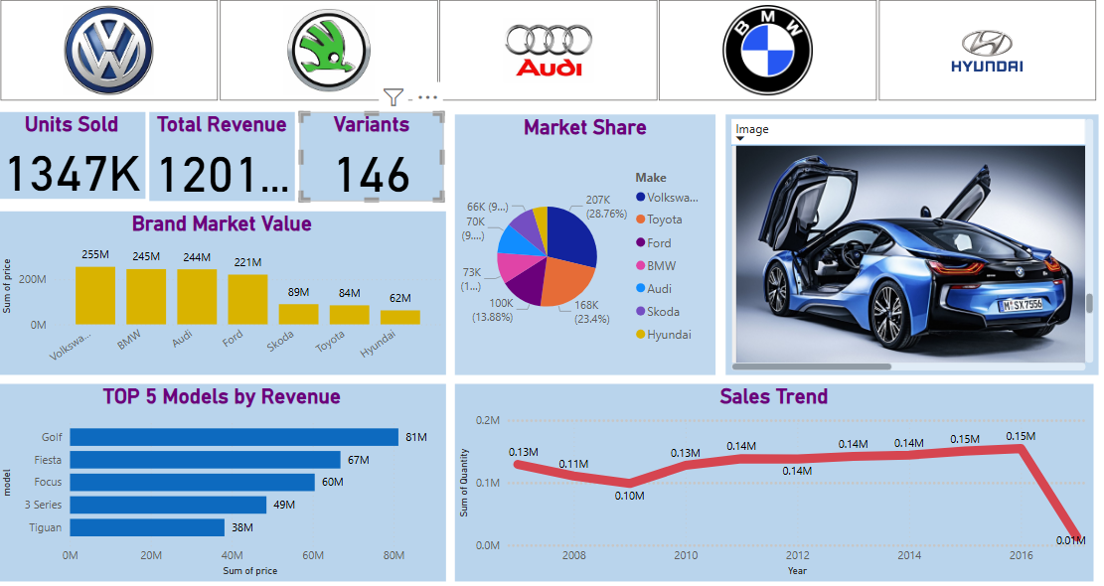




Power BI Dashboard – Overview
The Power BI dashboard provides an interactive and dynamic snapshot of the Norwegian car market.
Pricing Trends
Sales Analysis
Visualizes price fluctuations and identifies average pricing strategies.
Breaks down sales volume by various segments and tracks growth.
Brand Comparison
Compares performance and market positioning of leading car brands.

Slide 6
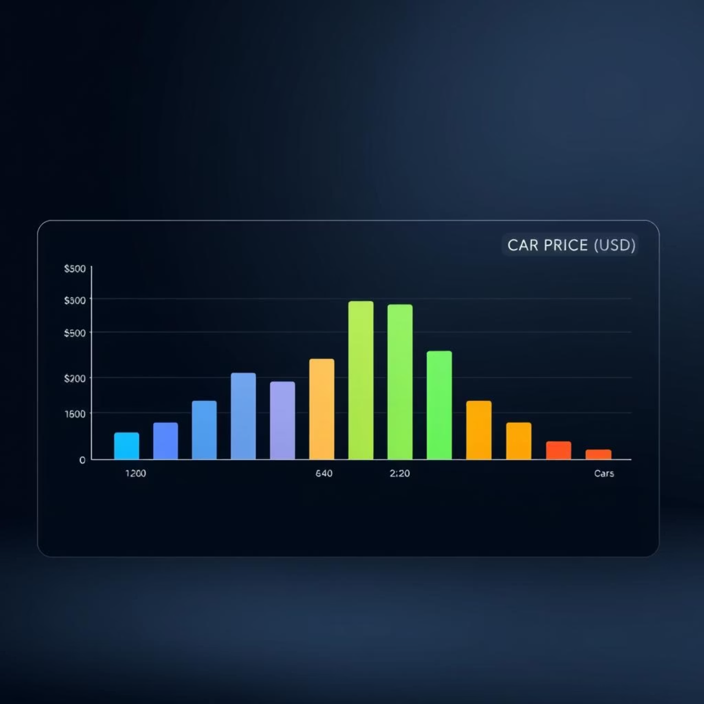
Price Distribution Analysis
A histogram illustrates the distribution of car prices, revealing common price ranges and variations.
Average Price: Identified the central tendency of car pricing in the market.
Minimum & Maximum Prices: Established the full range of prices observed.
Insights: Pinpointed outliers and distinctive pricing clusters, indicating market segments or premium models.

Slide 7




Factors Affecting Car Price
Correlation analysis uncovered the key variables influencing car prices.
Year
Mileage
Newer cars generally command higher prices due to advanced features and warranty.
Lower mileage typically correlates with higher prices, reflecting less wear and tear.
Transmission
Fuel Type
The type of transmission can influence price, with automatics often being more expensive.
Differences in fuel efficiency and environmental considerations impact pricing.

Slide 8
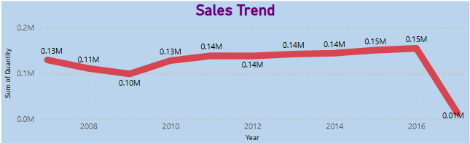
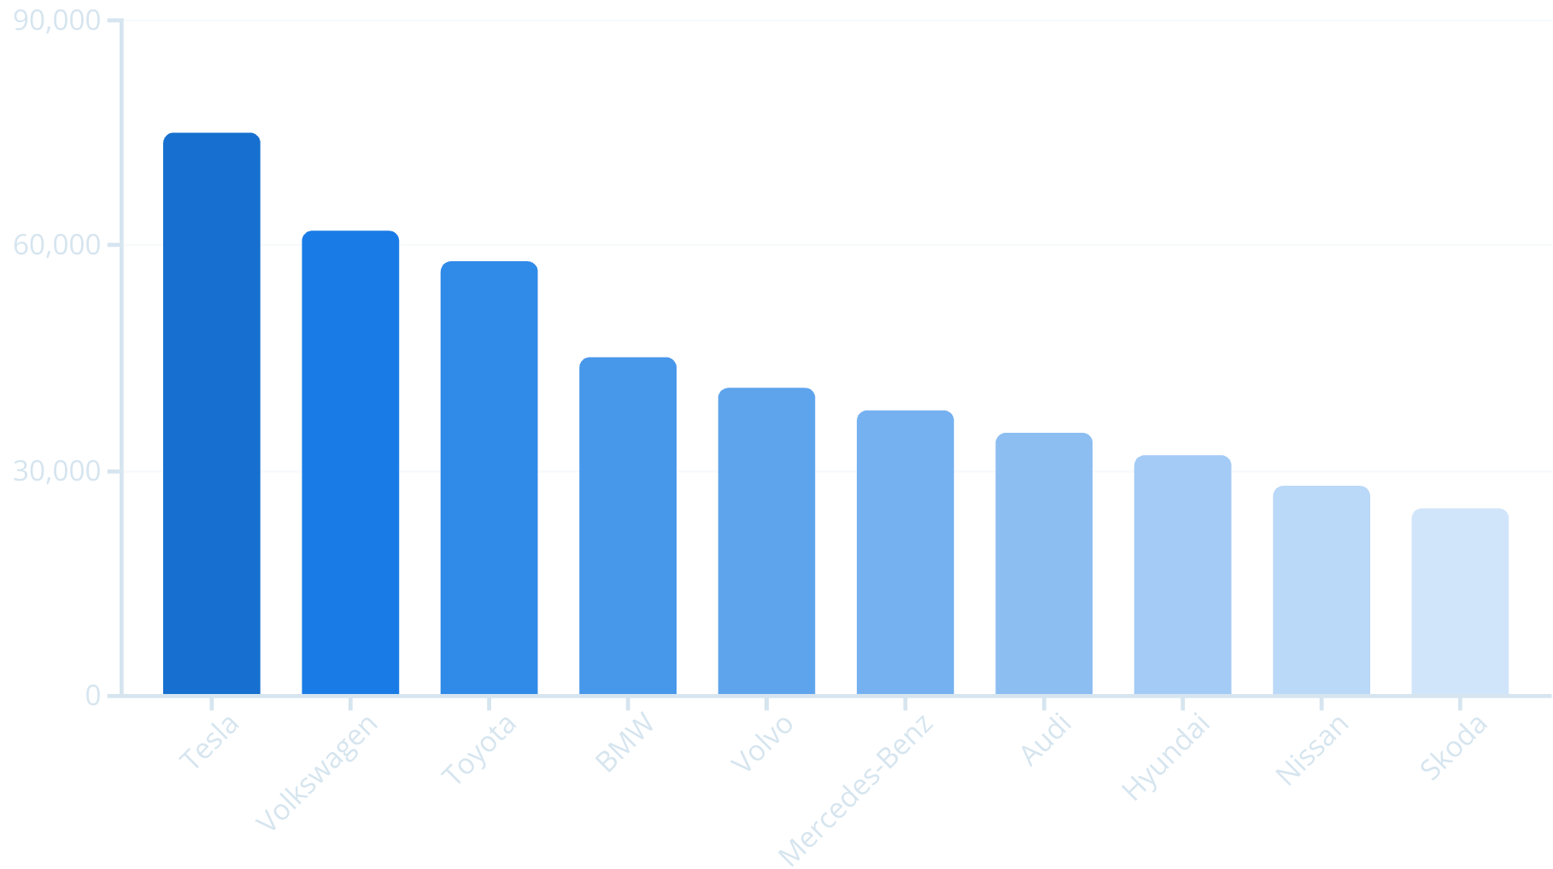
Norway Car Sales Analysis
An in-depth look into car sales trends across Norway reveals the dominance of top brands.
Top 10 Brands: Identified the leading manufacturers by sales volume in the Norwegian market.
Year-wise Trends: Analyzed historical sales data to understand growth or decline patterns over time.
Visual Insights: Utilized column and pie charts for clear representation of sales performance.

Slide 9
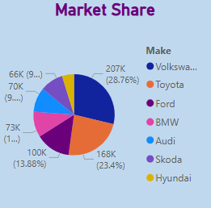
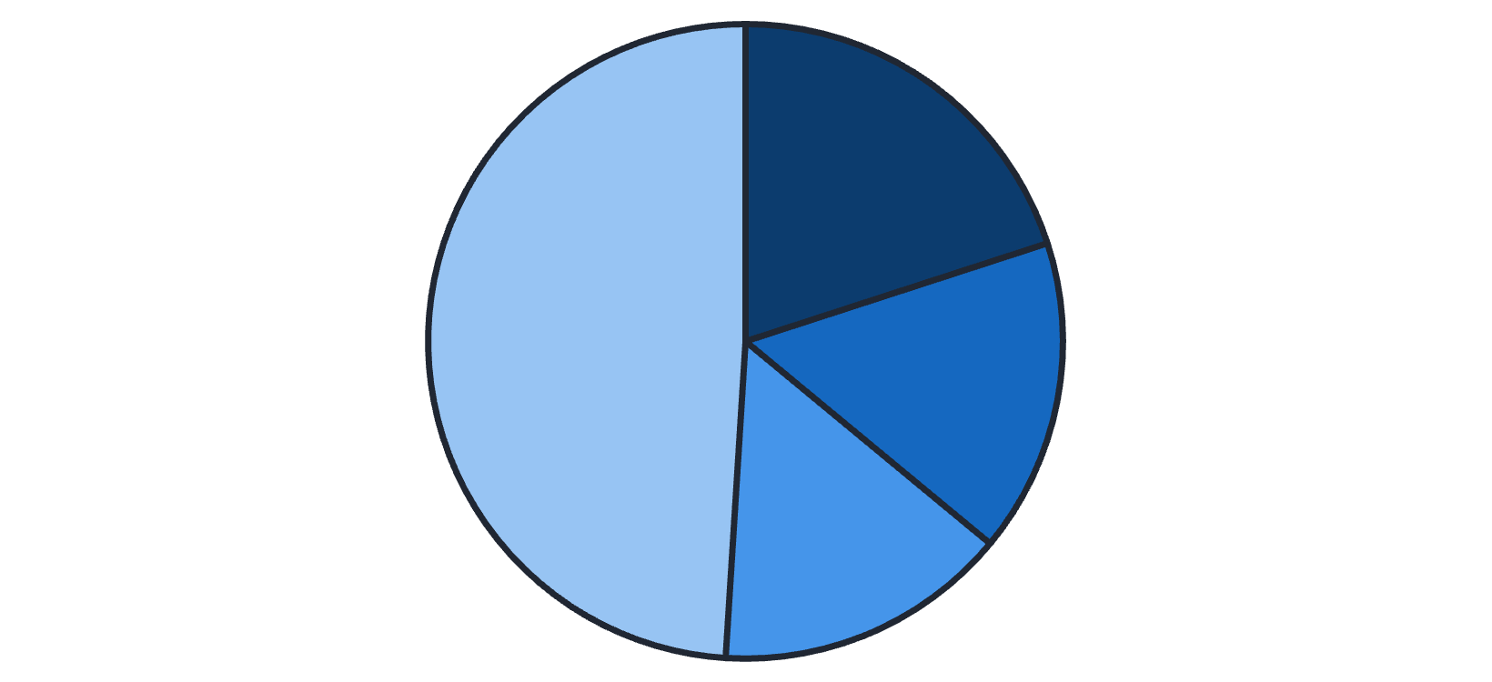
Market Share of Brands
The pie chart illustrates the distribution of market share among car brands in Norway.
Top 3 Brands: Clearly identified the brands holding the largest market control, indicating their strong presence.
Brand Diversity: Assessed the competitive landscape, highlighting the balance between leading brands and niche players.
Tesla
Volkswagen
Toyota
Market Dynamics: Provides insights into the level of competition and potential areas for market entry or expansion.
Others

Slide 10



Model-Level Insights
Diving deeper, we examined sales performance at the individual model level.
10%
7%
5%
Tesla Model Y
Volkswagen ID.4
Toyota RAV4
Leading the market in electric vehicle sales.
Strong contender in the compact SUV segment.
Popular for its reliability and hybrid options.
These detailed insights provide a granular understanding of consumer preferences and market demand.

Slide 11
THANK YOU

